Slide 1
Work Ethic

Slide 2
Lesson Objectives
Define the term work ethic, and the characteristics of having a strong work ethic.
Describe how a person’s work ethic can be tested from situation to situation.

Slide 3
Buzzer Beater
Identify 3 traits that characterize good work ethic. Identify 2 traits that characterize poor work ethic.
Notes:
Give the students 2-3 minutes to complete this. After they have finished, have them hold onto their papers with their answers on it. Show the video on the next slide then they will revisit their bell ringer.

Slide 4
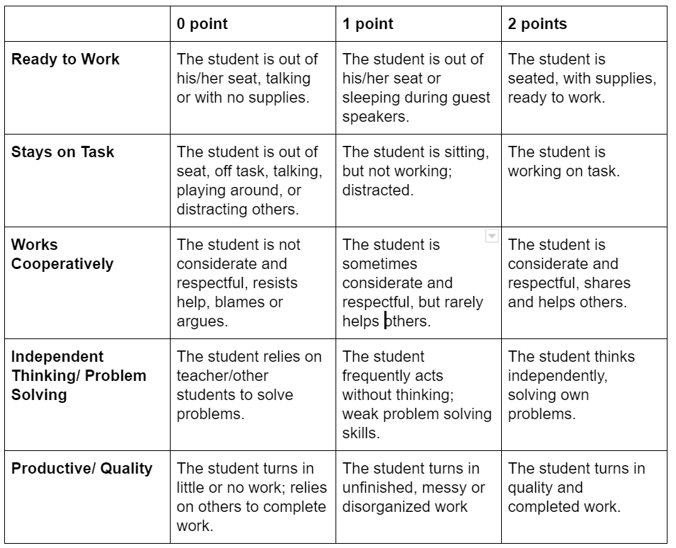
Work Ethic Grading:
Notes:
This is how you will be graded each week for your 10 point work ethic grade. This is individual. Teacher should hand out a copy or post it on google classroom so students know the expectation.

Slide 5
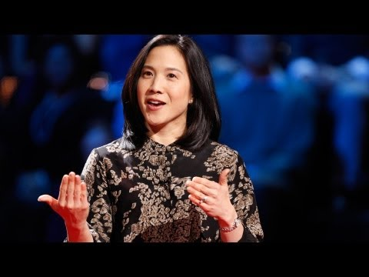
Work Ethic
Notes:
7 minutes long.
Teachers notes: Show this video about “grit”, which is essentially another term for work ethic.
Key Point: primary predictor of success was grit.
Grit is passion and perseverance for very long-term goals. Grit is having stamina. Grit is sticking with your future, day in, day out, not just for the week, not just for the month, but for years, and working really hard to make that future a reality. Grit is living life like it's a marathon, not a sprint.

Slide 6
Characteristics of Work Ethic
Attendance and punctuality
Goal Setting
Hard work
Positive Attitude
Accomplishment
Notes:
Now that you’ve watched the video, go back to your buzzer beater and see if you can update your list. Give the students 1-2 minutes to update their list. Then take another 5 minutes to have them share with the class and have a discussion. After the students have provided their answers and had a short discussion, you can put these 5 traits on the board.
Attendance and punctuality: Whether in school or work, you learn and accomplish most when you show up, on time and prepared. You can’t learn if you’re not there! And when you come late, it’s unlikely that you’re really ready to do your best work. Good attendance and punctuality are two important pieces of a good work ethic –and they’re easily addressed and accomplished.
Goal Setting: Before you can accomplish your goals, you need to know what they are. People with good work ethics are goal-oriented and dedicated to achieving the success they envision. They understand that there are many steps to success and they’re willing to take them all.
Hard work: At the foundation of a good work ethic is a whole lot of hard work. In school, it may mean staying after for extra help from your instructor or fine-tuning your assignments to reach perfection. At work, you may want to come in a little early or stay late so you do the best job you can.
Positive Attitude: Your positive attitude can set you apart from your peers –and it can be infectious, spilling over to other employees and making you welcome on any work project. Approaching every task—big and small—with a good attitude shows that you’re a team player dedicated to not just your own success, but also to the success of your company.
Accomplishment: The more you accomplish, the more likely you will be the person chosen for further advancement. Your good work ethic is likely to be recognized, acknowledged and rewarded and can serve as a building block to you future success.
https://www.porterchester.com/news-events/importance-good-work-ethic-school-life/

Slide 7
Self Evaluate your Work Ethic
Now that you know what is considered good work ethic, take a moment to self evaluate your work ethic.
Notes:
Teacher should hand out work ethic self evaluation. Students should spend about 3-5 minutes completing this quiz. This is not for a grade and will not hurt them, even if they rate themselves as having poor work ethic. However, it should help them take a good look at their life and hopefully self reflect.

Slide 8
Work Ethic Dilemma
Lee loves making extra money by babysitting. She regularly babysits for four families. This week, she has two jobs lined up, one for Wednesday evening while Mrs. Stevens goes grocery shopping, and the other for Friday night while Mr. and Mrs. Lyons go out to dinner. All week, Lee’s best friend, Melissa, has been telling her about a special event for which she has tickets. Melissa’s parents bought tickets for her entire family to attend a grand opening party for a music theater at Wednesday from 5 to 10 PM. Many bands would be performing throughout the evening, including Lee’s favorite band, Imagine Dragons. When Lee gets home from school on Wednesday, her friend Melissa calls to say that her dad will be working late and can’t use his ticket. Melissa invites her to attend the party and tells Lee, “You can just tell Mrs. Stevens you’re sick! When will you ever get to see Imagine Dragons again? For FREE?” It was 2:30, and Lee was supposed to be at Mrs. Stevens’ house at 5:00. What should she do?
Notes:
Reference: https://www.juniorachievement.org/documents/20009/1187238/Elementary4.pdf
Let students read through this scenario. After they have finished reading it, as a group, brainstorm all her options. Write ideas on the board. Possible answers could include:
• Say “no” to Melissa and follow through with the commitment.
• Call and cancel – telling Mrs. Stevens the truth.
• Call in sick. Make up an excuse.
• Ask Mrs. Stevens if you could reschedule for the following evening. If she says no, this would mean you would do the babysitting job as planned.
• Babysit then and meet Melissa at the event after you’re done.
• Do not call or show up to babysit.
Take 5-7 minutes to discuss the consequence of each option for Lee and for Mrs. Stevens. Sort through each option, discussing the ethics involved with each one. Connect each one back to the ideas of dependability, responsibility, honesty, level or rigor, and level of innovation to which it applies.

Slide 9
Work Ethic Dilemma
Can your work ethic change from situation to situation? If so, how can you always be sure you are making the best decisions for yourself and your work?
Notes:
Explain that most people use questions to help guide their decisions. These include:
• Would this make me proud?
• How would I feel if everyone I knew found out what I had done?
• Is this the right thing to do?
• Would I want someone to do the same thing to me (the Golden Rule)?

Slide 10
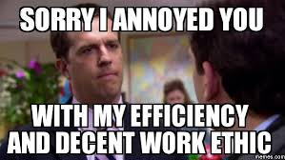
Work Ethic Project
Notes:
The teacher should put the students into groups. These groups should be different than last weeks groups. They should stay in these same groups for the next lesson which is on teamwork. Select one of the two projects options from the folder. There is a document giving instructions for each option.
Image Source: https://goo.gl/images/VBQm9i

